Slide 1
Enterprise Risk Management (ERM)
DRAFT
GRC – Cyber Security
V0.3 8th May 2025

Slide 2

What is Risk Management?
Definition of Risk Management:
The coordinated activities to direct and control an Enterprise with regard to risk [1]
What is the function?
Enterprise risk management (ERM) is a comprehensive and structured approach to risk identification, risk assessment, risk response, and risk monitoring [2].
ISACA ©
ISACA. (n.d.). CRISC™ Review Manual 7th Edition
CLA, 2023

Slide 3
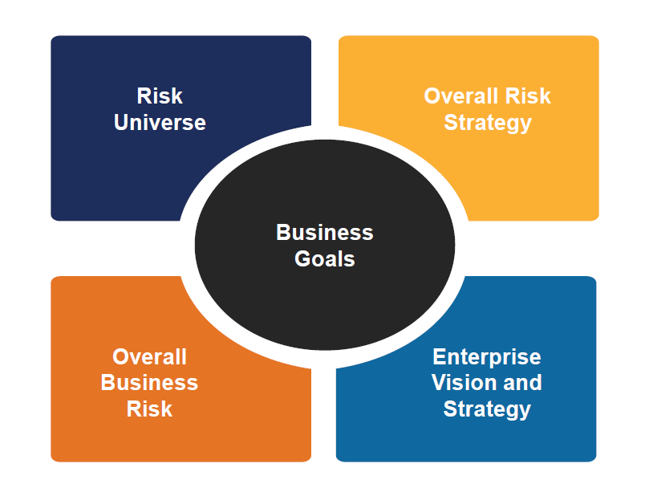
What is the business benefit to Redback Operations?
Improved / Enhanced Decision Making
Resource Efficiency
Greater Risk Awareness
Greater Stakeholder Confidence
Supports business strategy by protecting sensitive data and maintaining operational continuity
ISACA ©

Slide 4
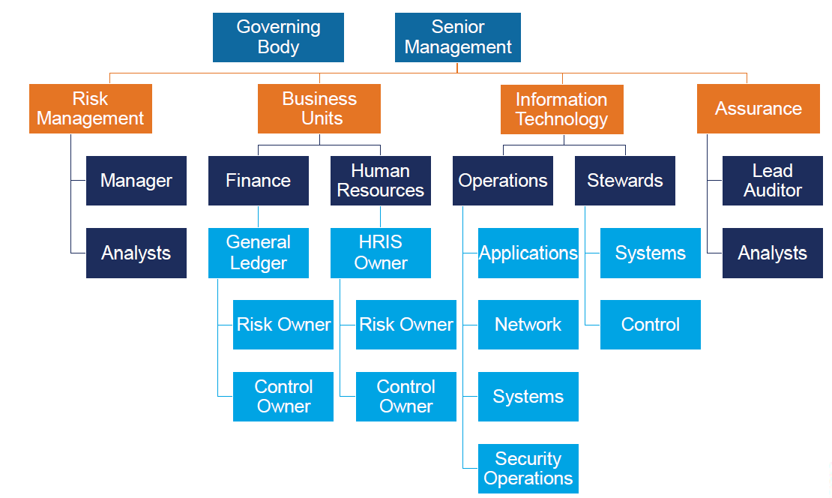
Where does Risk Management reside in an Enterprise?
Discrete Entity in an organisation (doesn’t perform BAU or Operations)
Reports to Senior management and the governing body
ISACA ©

Slide 5

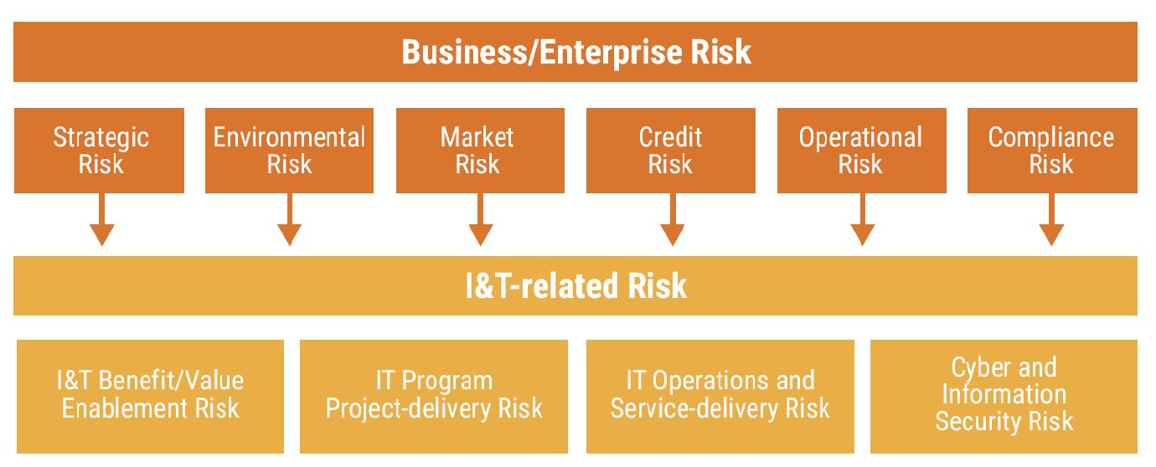
How does IT Risk align with Enterprise Risk?
IT risk is a subset of Enterprise Risk Management but can be implemented as a stand-alone function
ISACA ©

Slide 6
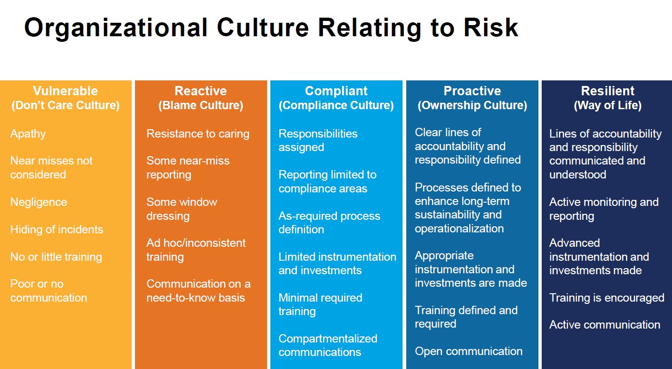
Risk Culture
Where do you think the culture lies in Redback Operations ?
ISACA ©

Slide 7
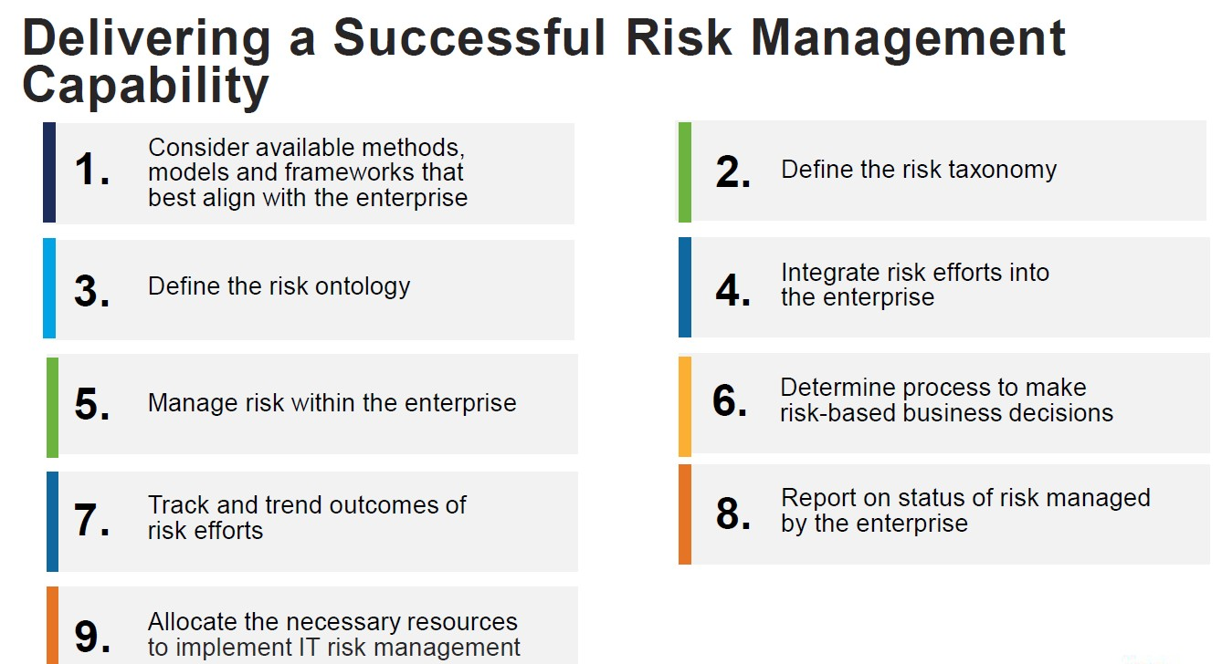
ISACA ©
What is an ERM Framework?
An ERM framework is a set of principles and procedures that help the organization manage anticipated risks so that it can successfully achieve its objectives (Oracle)
Examples
NIST RMF, COBIT, ISO 31000..and many more!

Slide 8
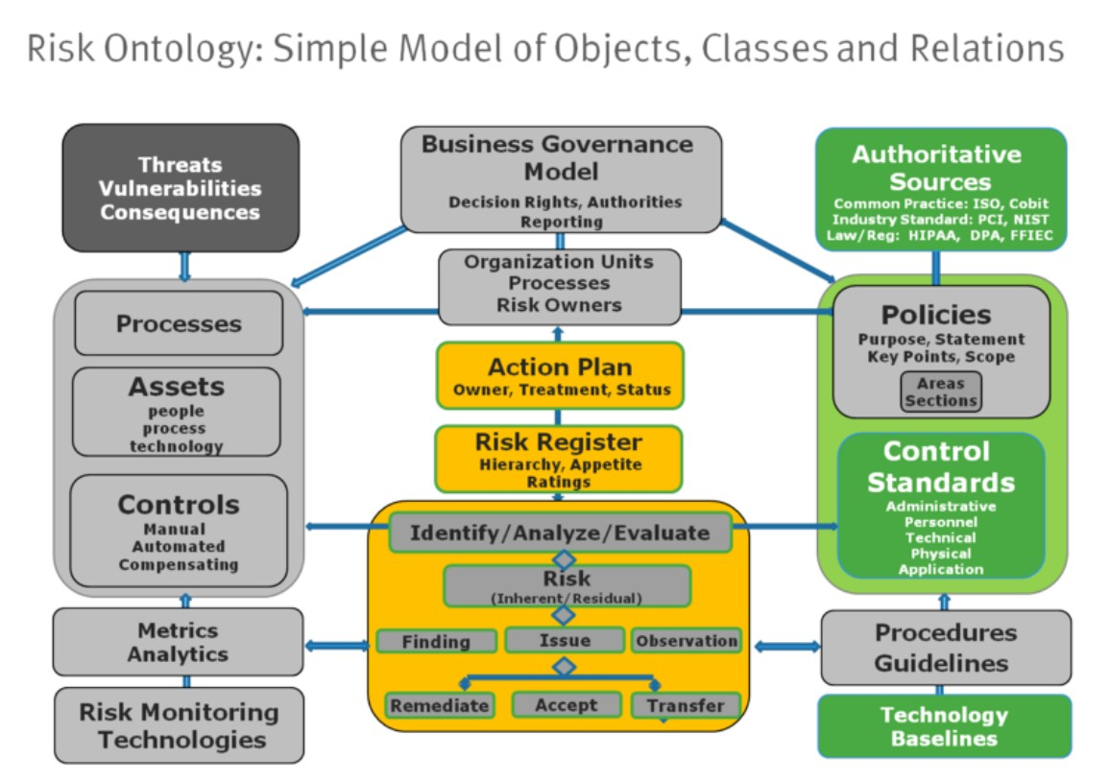
Ontology vs Taxonomy
Risk ontology is a collection and relationships between Objects , Classes and relationships
Risk Taxonomy is a hierarchical structure for categorising and organizing risk. It provides a common language for identifying, assessing and managing risk.
ISACA ©

Slide 9
Value of a Risk Management Framework
Guides the management of information security risks
Identifies assets and establishes context
Sets scope of risk assessments and organisational risk tolerance / appetite
Assists in determining the significance of specific risks and guides strategic planning

Slide 10
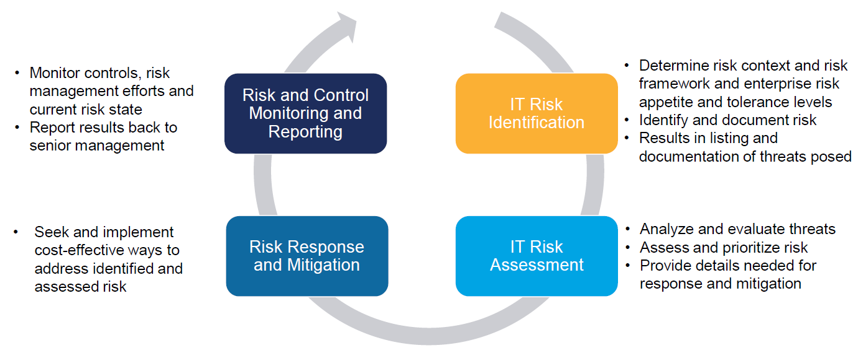
Risk Management Lifecycle
Risk Management Lifecycle
ISACA ©

Slide 11
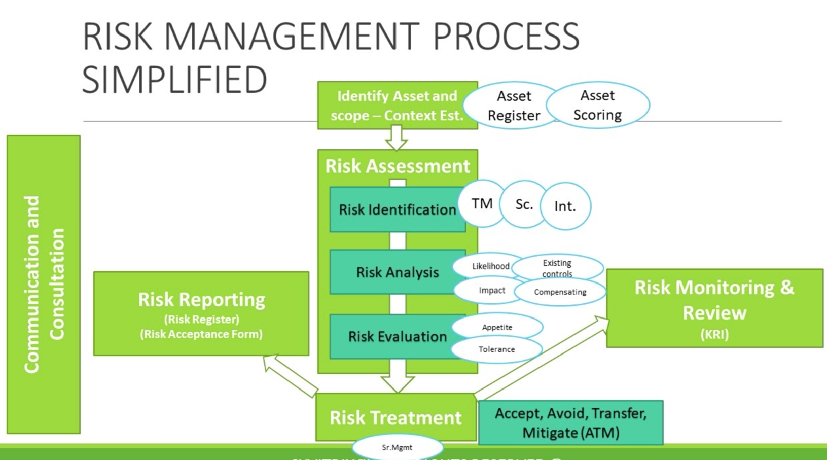
ISACA ©

Slide 12
What’s (Possibly) Next?
Finalise the Risk Management Overview Pack (done)
Have a Peer review session within GRC Team (done)
Present the pack to Redback Enterprise Steering Committee to garner executive support (in progress)
Utilise ERM framework to establish Risk Management (Future)
Risk Register (template)
Risk Management Policy (template)
Risk Governance
Reporting

Slide 13

Any Questions?
GRC Team – Cyber Security

Slide 14
Thank You ☺
GRC Team – Cyber Security

